Slide 1
Beyond the Hype: How AI Is Reshaping Our Future
Understanding the real Impact of AI

Slide 2
The AI Revolution
AI is the biggest technological shift since the internet.
It’s changing how we work, learn, create, and communicate.
AI is not science fiction; it’s part of our daily lives.

Slide 3
The Hype Vs Reality
AI will take over the world | AI is powerful but still limited
AI learns on its own | It learn from data we provide
AI will replace humans | It’s augmenting human abilities
AI is neutral | It reflects our biases
Our goal is to go beyond the hype; and see the real capabilities and challenges of AI.

Slide 4
What Exactly is AI?
The ability of machines to perform tasks that require human-like intelligence.
It includes:
Machine Learning: learning from data.
Deep Learning: Neural Networks that mimic the brain.
Natural Language Processing (NLP): Understanding text and speech.
Computer Vision: Recognizing images and objects.

Slide 5
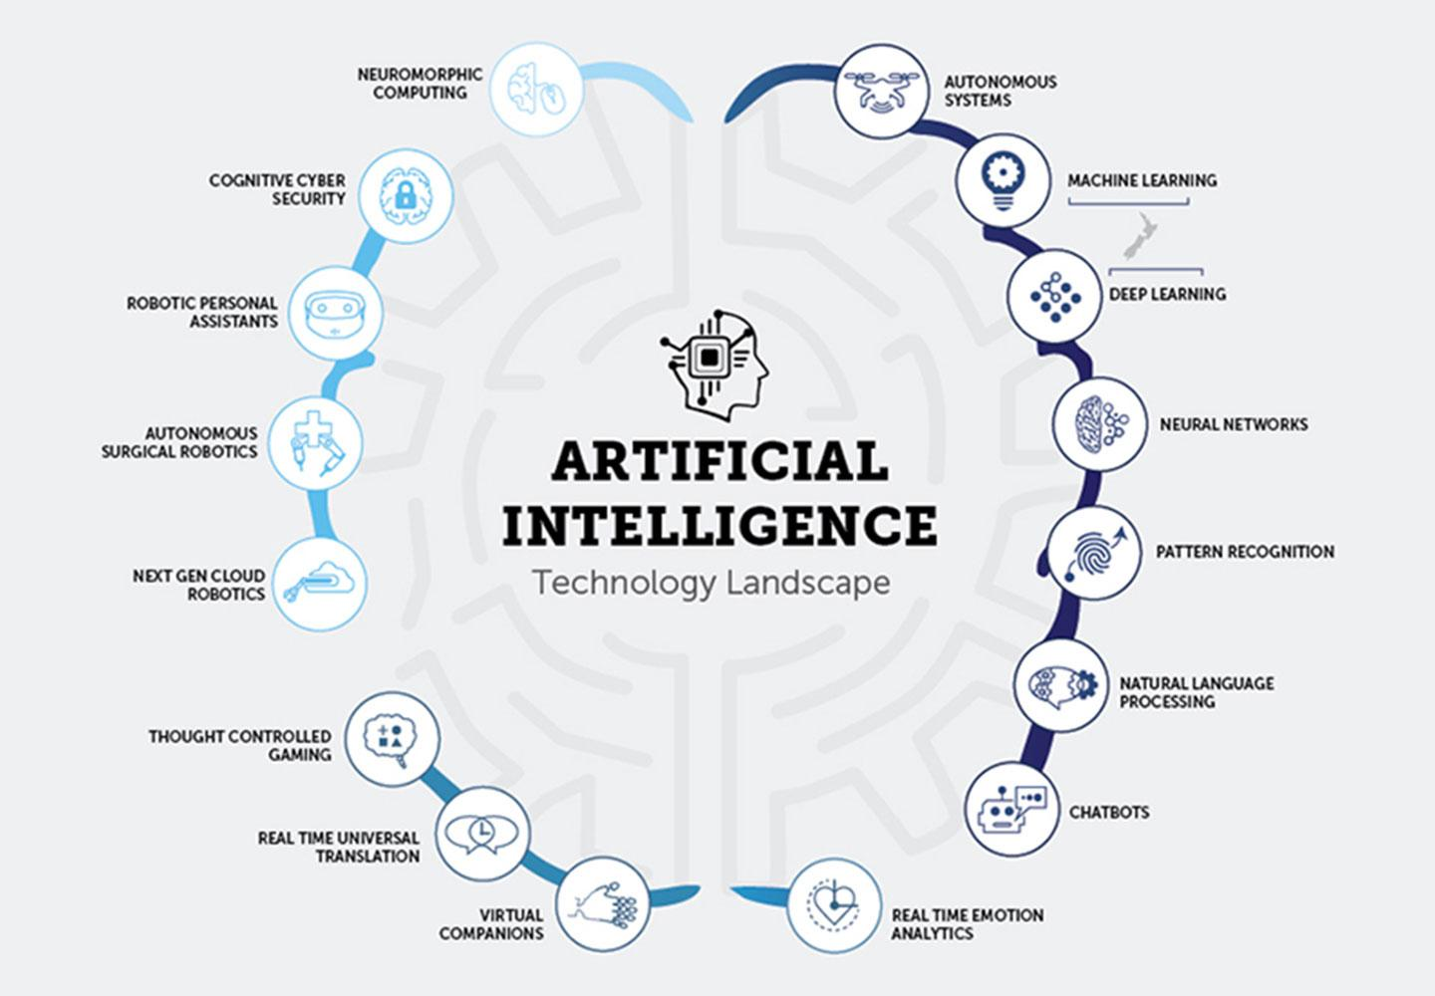
What Exactly is AI?

Slide 6
The Evolution of AI
1950: The dream of intelligent machines begins.
1980s: Expert systems.
2010s: Deep learning and big data
2020s: Generative AI (ChatGPT, Midjourney, Copilot)
Note: Ai evolved over decades; from theory to real-world tools that now create text, art, and code.

Slide 7
How AI Works
Data Collection: Gathering Examples.
Training: Feeding data to models.
Testing: Checking performance.
Deployment: Using the model in apps
Feedback loop: Continuous Learning.
Note: Think of AI as a student: data is the teacher, and the model learns by example.

Slide 8
AI In Everyday Life
Google Maps: Route Optimization.
Netflix: Movie recommendations
Gmail: Smart replies.
Camera: Face Detection
ChatGPT: Text generation
Note: You interact with AI more than you realize; It’s quietly behind the tools we depend on.

Slide 9
AI in Healthcare
Early disease detection.
Personalized treatments.
Drug discovery.
Medical imaging analysis.
Google DeepMind detects 50+ eye diseases from scans.
Note: AI assist doctors, reduces error, and accelerates discoveries; not replaces them.

Slide 10
AI in Finance
Fraud detection systems
Credit Scoring
Algorithmic trading
Chatbots for customer service
Note: Banks rely on AI for security and speed; analyzing thousands of transactions per second.

Slide 11
AI in Education
Personalized learning paths.
Automated grading.
Language learning chatbots.
Virtual tutors.
Note: AI tailors education to each learner; transforming one-size-fits-all classrooms into personalized experiences.

Slide 12
AI in Creativity & Media
AI-generated art, music, writing, and video
Tools like Chatgpt, DALLE, Runway, Sora
Co-creation: Human + AI collaboration
Note: AI is not replacing artists; It’s giving them new creative superpowers.

Slide 13
Ethical Challenges
Bias: AI learns human prejudices
Privacy: Data misuse and surveillance
Misinformation: Deepfakes and fake news
Accountability: Who’s responsible for AI’s decisions?
Note: AI can amplify our biases; making ethical awareness critical for all developers and users.

Slide 14
The Human Side of AI
AI cannot feel empathy, emotion, or creativity (yet).
Human judgment remains irreplaceable.
AI works best with human, not instead of them.
Note: We need human intelligence to guide artificial intelligence.

Slide 15
The Global Divide
AI-rich vs AI-poor countries.
Unequal access to data, compute power, and education.
Need for inclusive AI development.
Note: AI progress must be global — otherwise, it widens the gap between nations.

Slide 16
AI and the Future of Work
Repetitive jobs automated.
Rise of hybrid human-AI teams.
Lifelong learning becomes essential.
Note: AI won’t replace people who adapt — it will replace those who don’t.

Slide 17
Future Trends to Watch
Multimodal AI: Text + Image + Voice + Video
Edge AI: Running models on local devices
AI Regulation: Ethical and legal frameworks
Sustainable AI: Reducing energy costs of training models
Note: The next phase of AI will focus on integration, safety, and sustainability.

Slide 18
Building an AI-Ready Mindset
Stay curious and adaptable.
Learn data literacy and critical thinking.
Use AI responsibly.
Collaborate across disciplines.
Note: AI isn’t just about technology — it’s about mindset, ethics, and continuous learning.

Slide 19
Closing Thoughts & Q&A
AI won’t replace humans — but humans using AI will replace those who don’t.
Embrace change, not fear it.
Learn to use AI wisely and ethically.
The future is not AI vs humans — it’s AI for humans.
Note: End on an inspiring note. Invite questions, ideas, and open discussion.

